Slide 1
CSI4142 Project
File created on: 2019-04-03 12:55:24 PM EDT

Slide 2
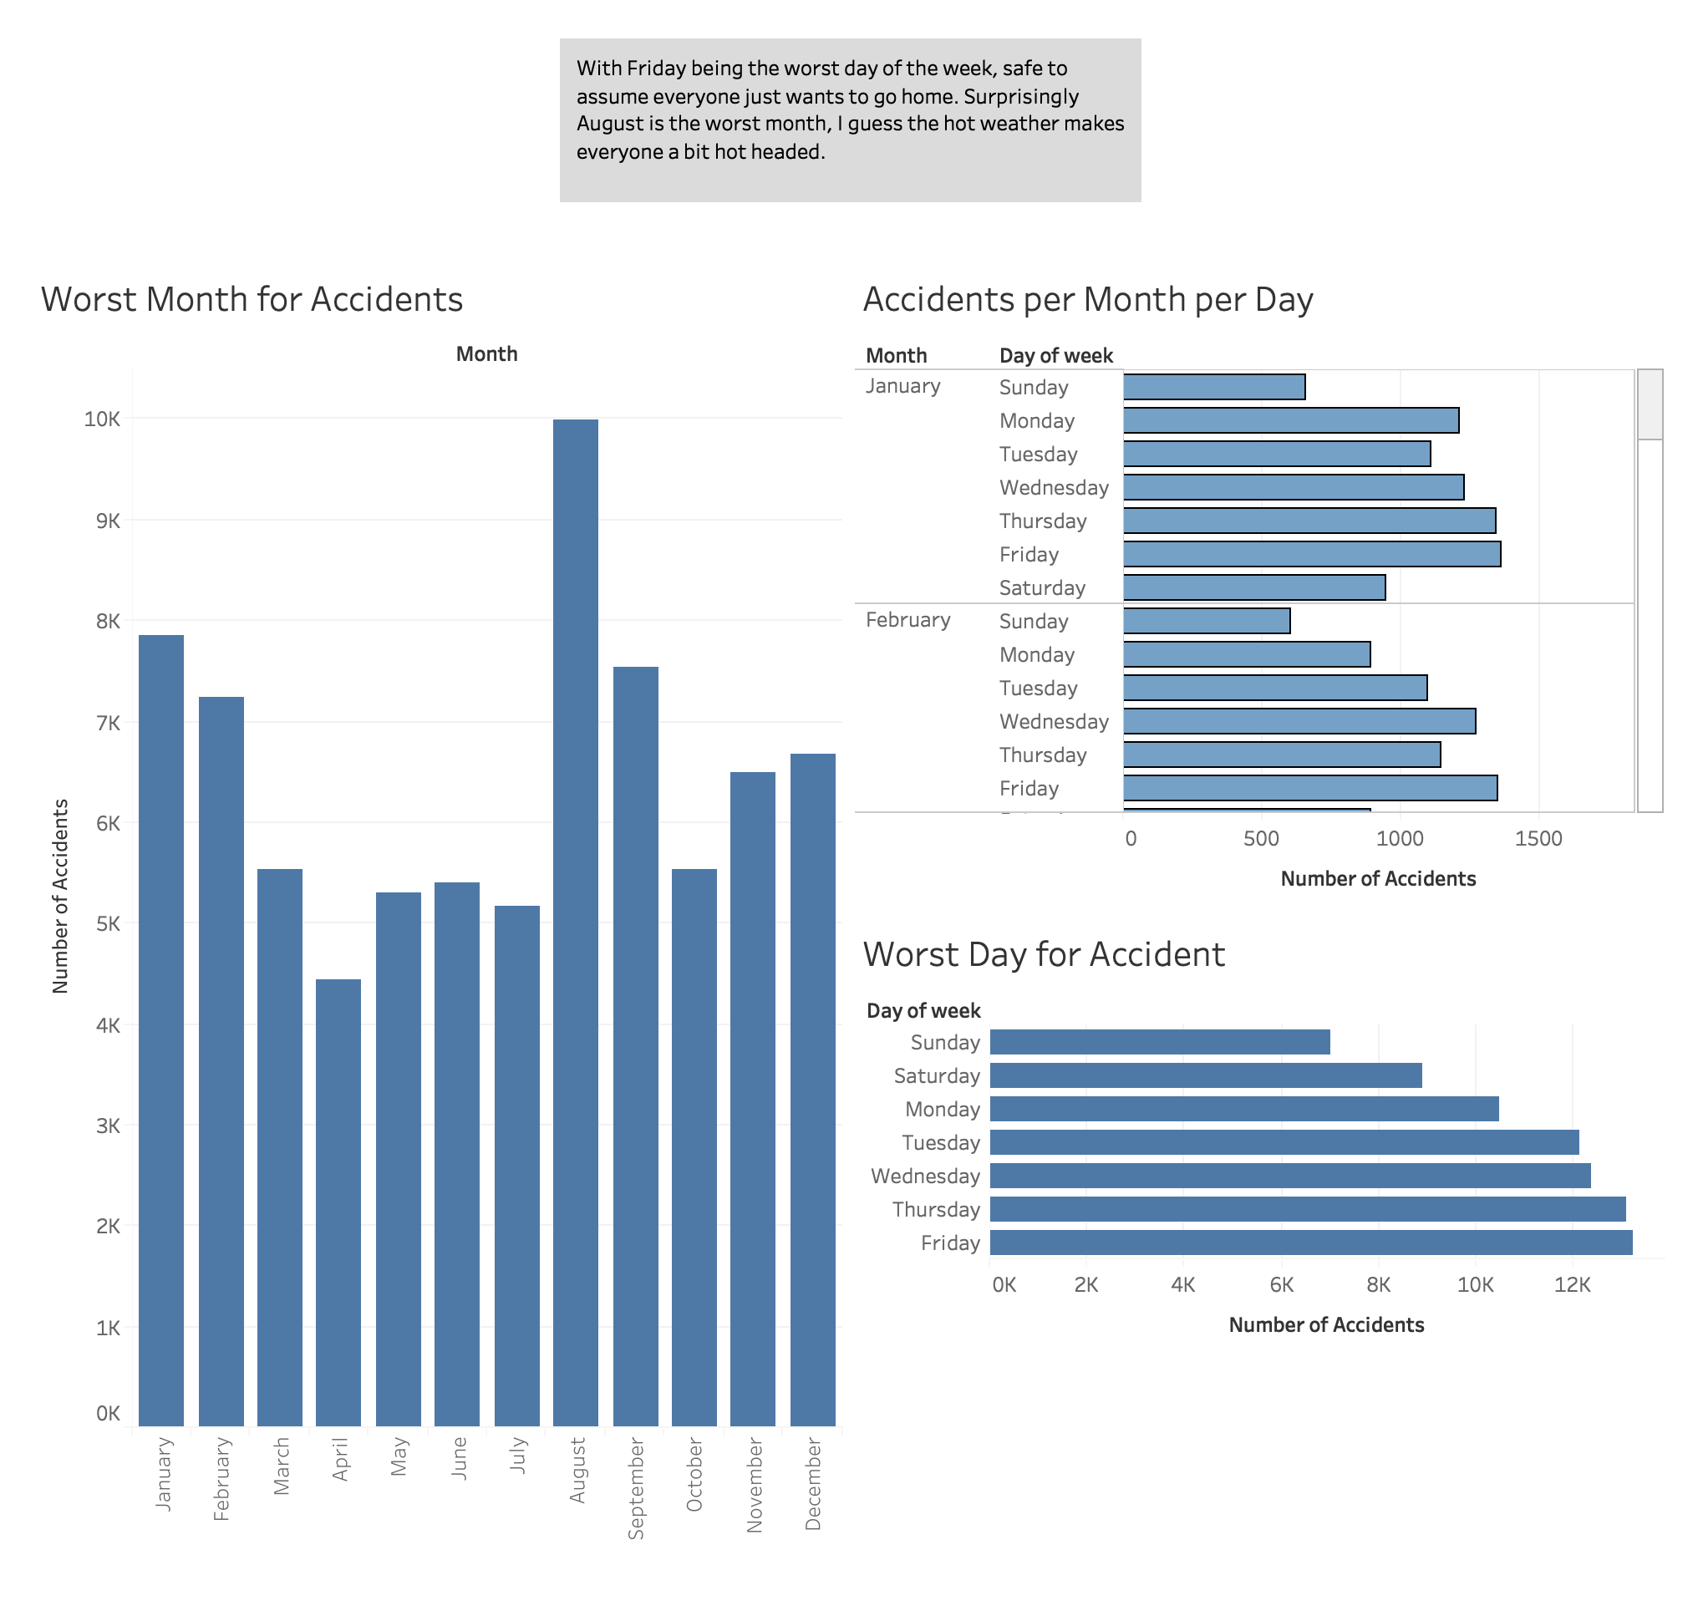
Notes:
When looking at the day of the week with the most accident, it was surprising to see that the worst days weren’t the weekends. Instead it was the 3 days leading up to the weekend. It was even more surprising to see that the month with the most amount of accidents wasn’t a winter one, but instead a summer month. I would have never known this without the Dashboard.

Slide 3
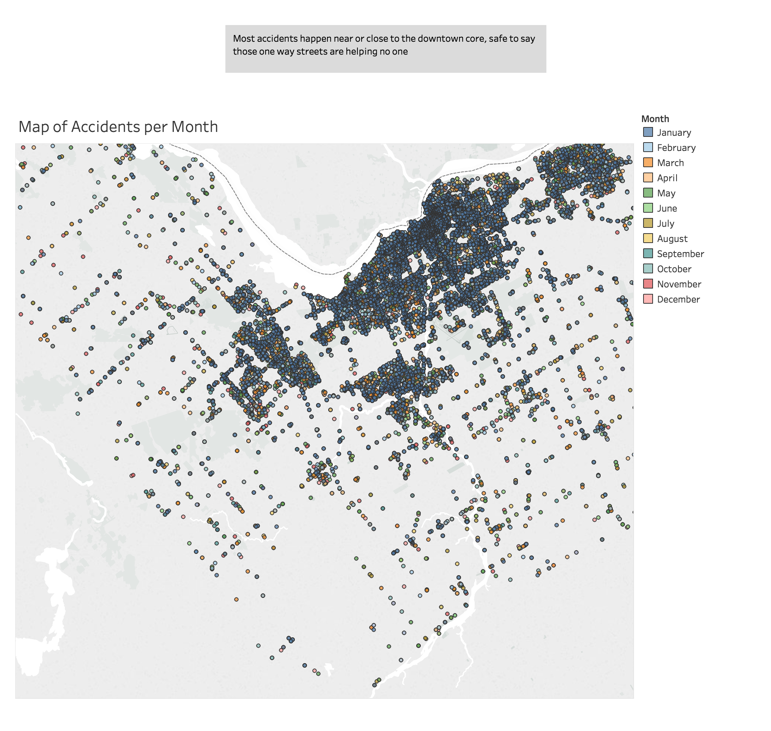
Notes:
It can be seen that most of the accidents do near the dense areas such as downtown, and the further one moves away the less accidents there are. This can be attributed to the fact that more people traverse these area, therefore there is more of a chance for accidents to occur, it can be seen that accidents again start to occur more frequently

Slide 4
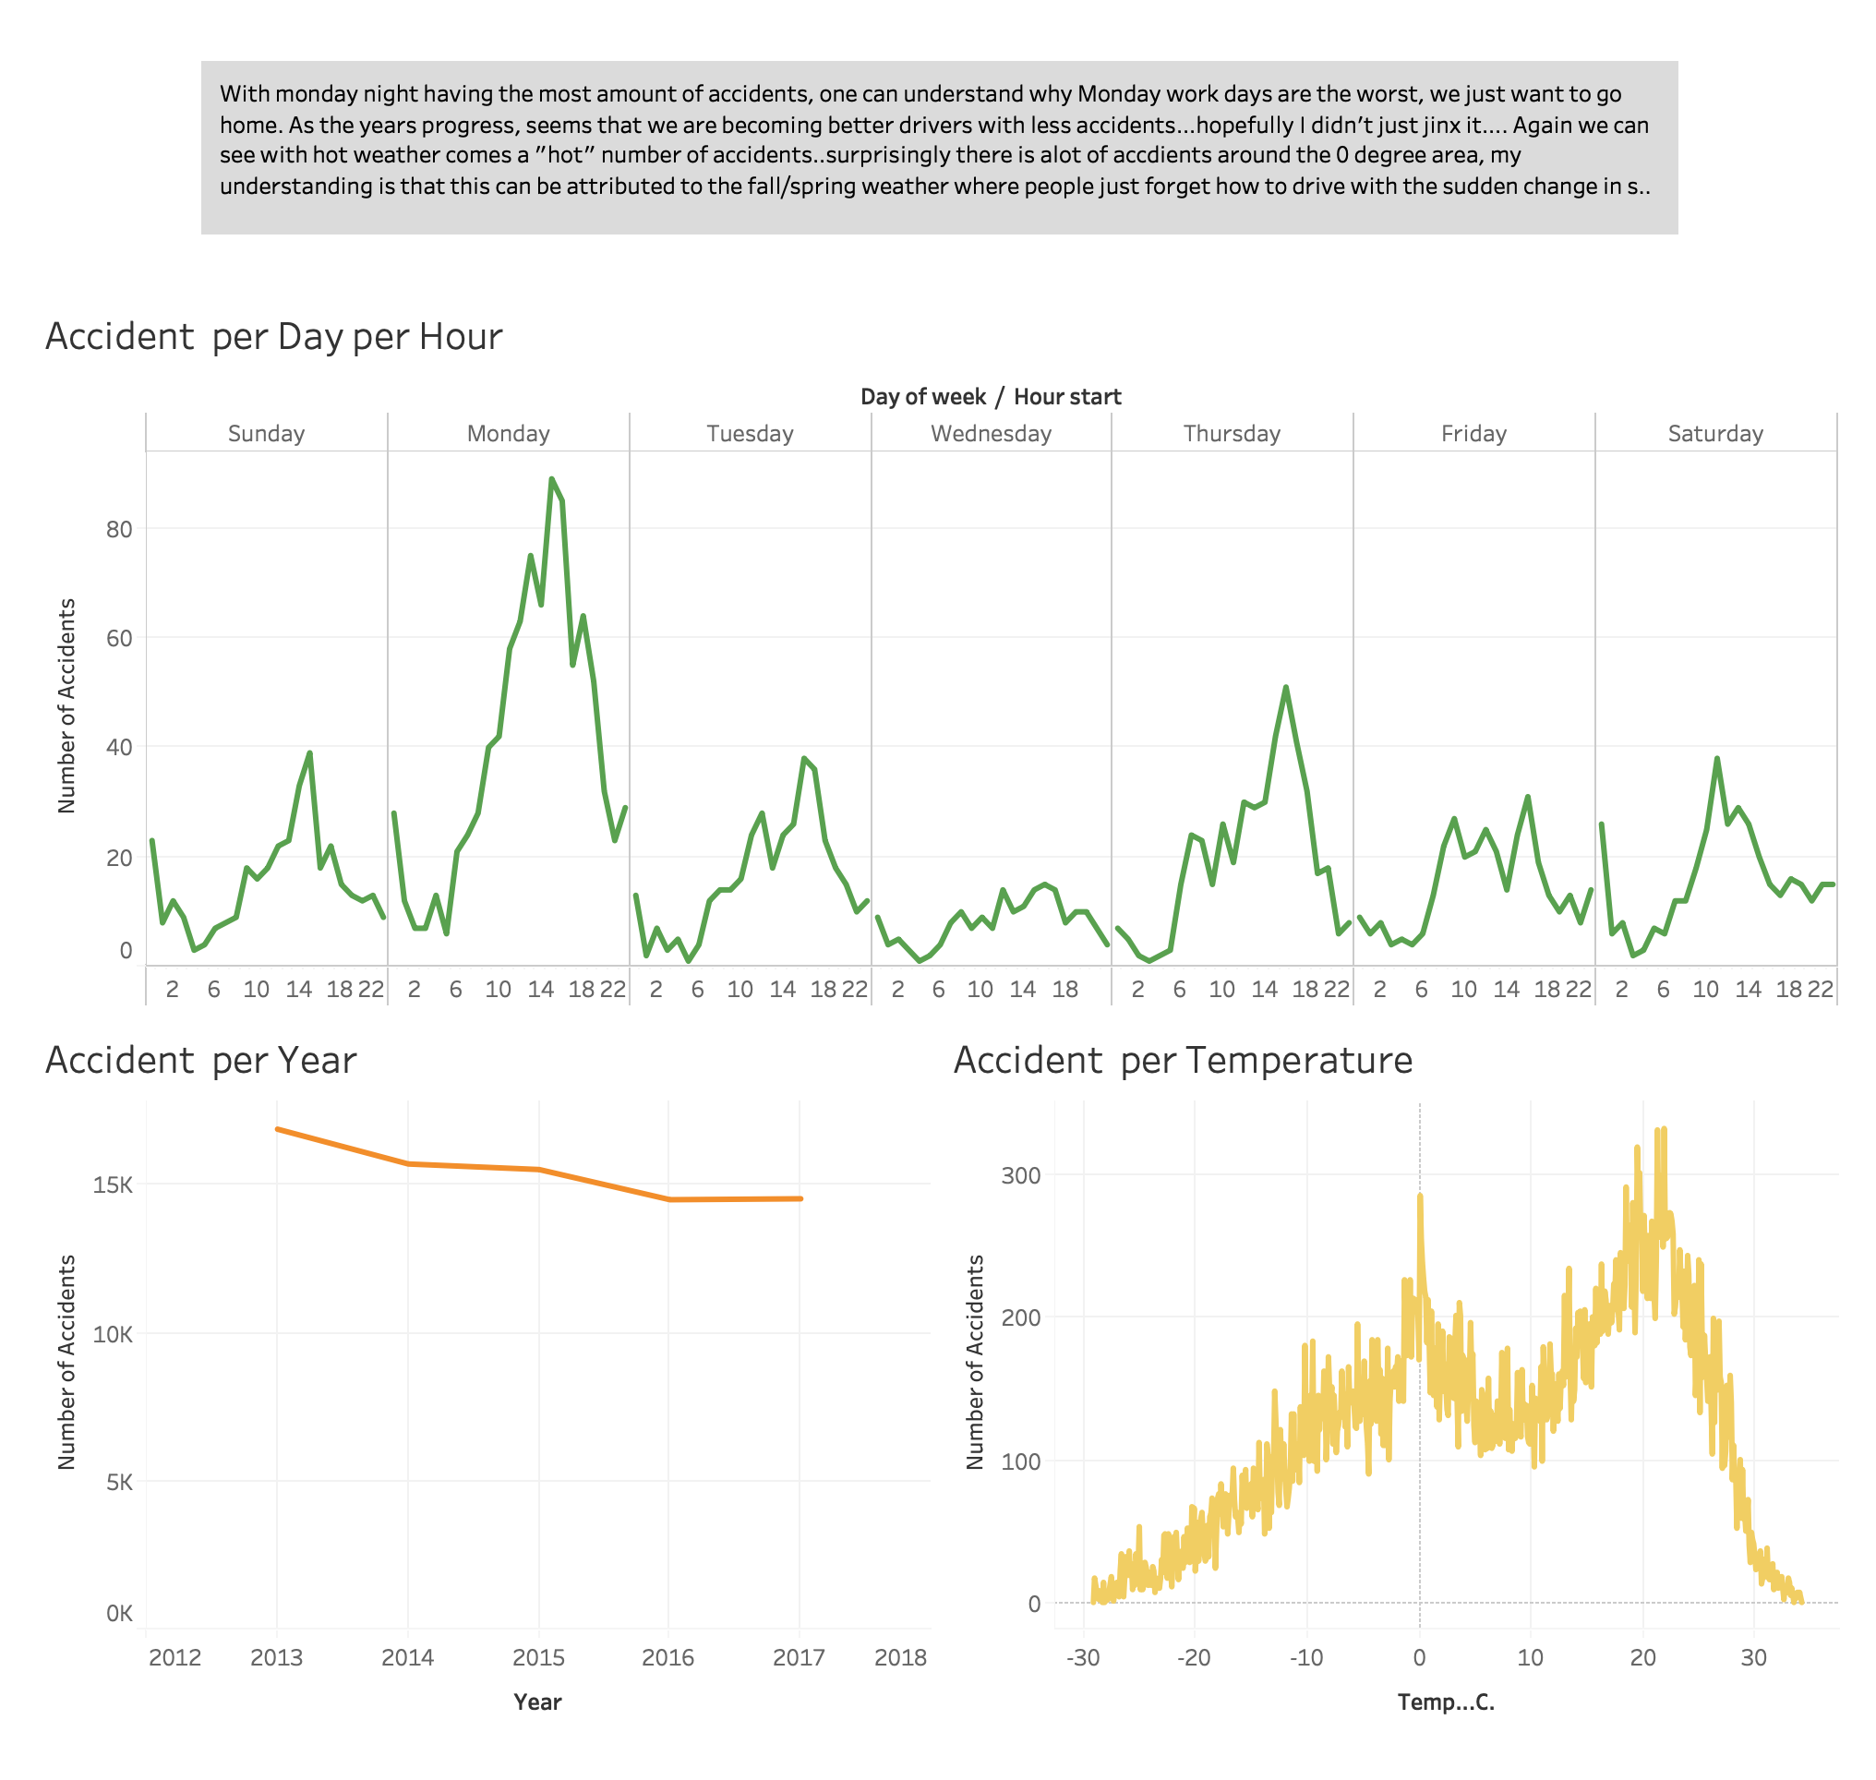

Slide 5
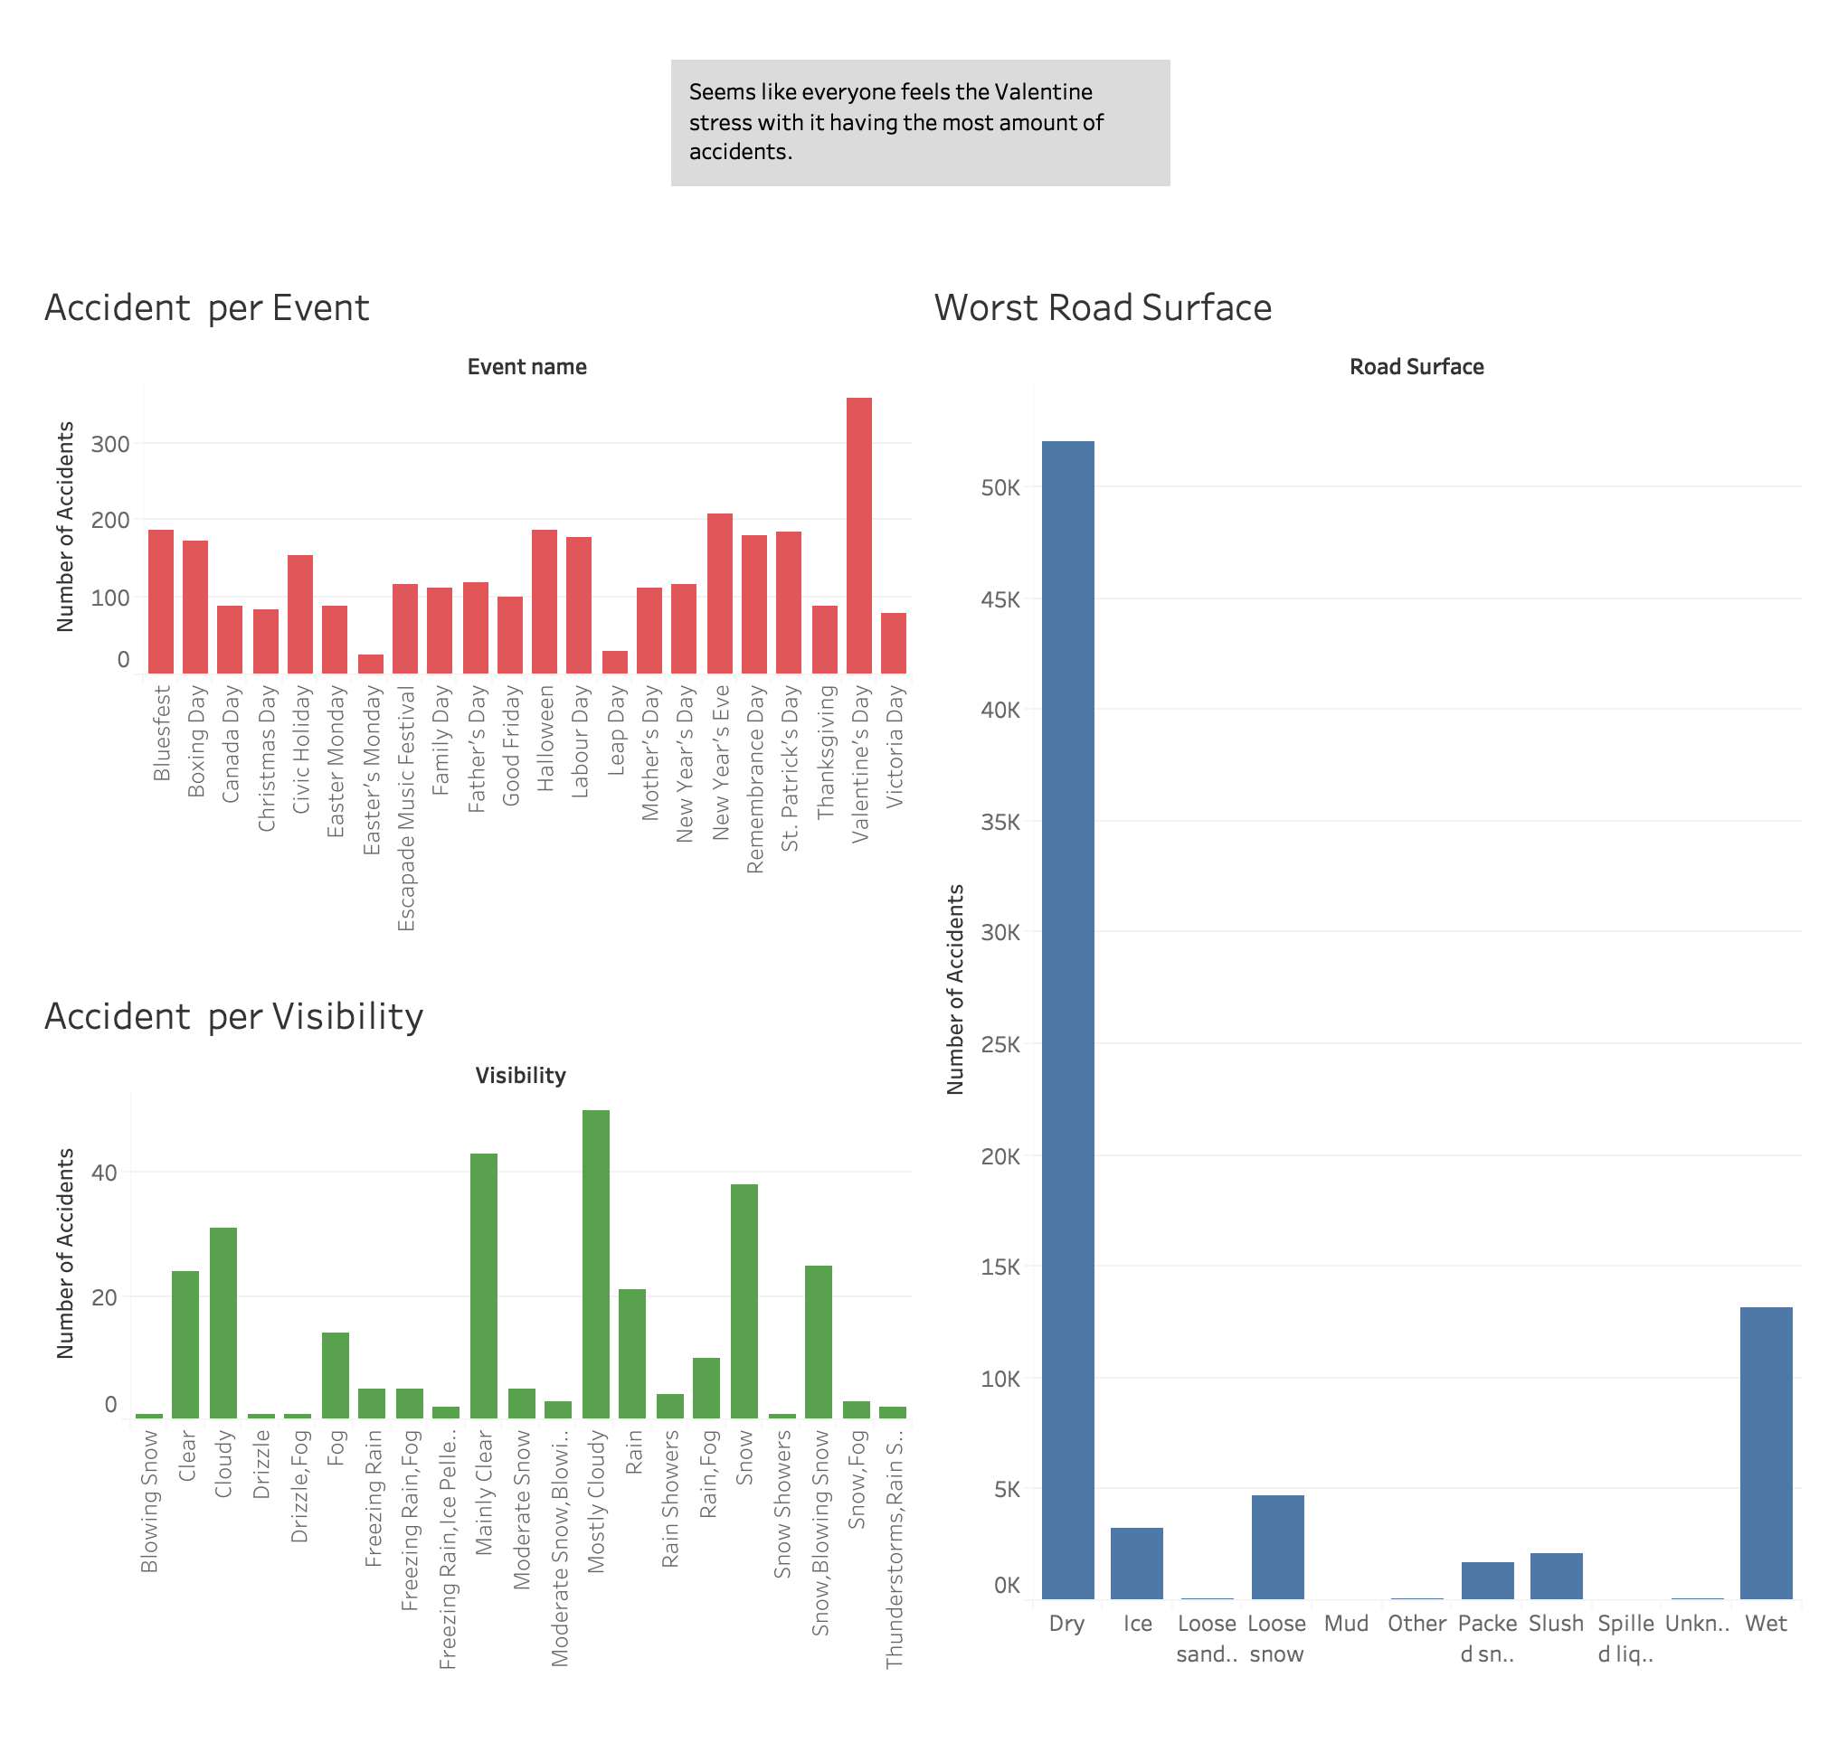

Slide 6
